Slide 1


SAP UI5 & FIORI with OData TRAINING
Anubhav Oberoy & Nishan Nainsukha
Day – 11

Slide 2

Agenda
What is Fiori
Structure of Fiori Project
Structure of Fiori App setup
What is component.js
Important parts of component.js file
Skeleton of Component.js
App Overview: The basic fiori App
List Control

Slide 3
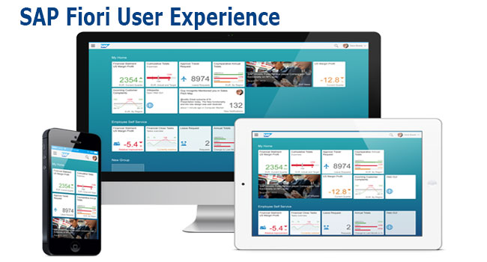
What is Fiori ?
Fiori is SAP’s new user experience. These are standard apps delivered by SAP and by following the Development guidelines any one can use UI5 to create fiori Apps.
Fiori is a streamlined application, delivering a role-based user experience that can be personalized across all lines of business, tasks and devices.
It uses tiles to encapsulate standard tasks like viewing sales orders or approving timesheets.
Fiori = UI5 + Development/Design Guidelines

Slide 4
Structure project
There are different folders and directory are required for setup project: webapp, Controller, models, utils ,view, Component.js, manifest.json, index.html
BaseController
Index.html
(Testing)
Decoupling
Ns,lib,view….
Call Component.js
sap/ui/core/UIComponent
Root view
App.view.xml
App.controller
Component.js
Container Control
App, SplitApp,FlexibleColumnLayout
View 1
Controller
Component container
R
View 2
Controller
manifest.json
Component.js is starting point

Slide 5
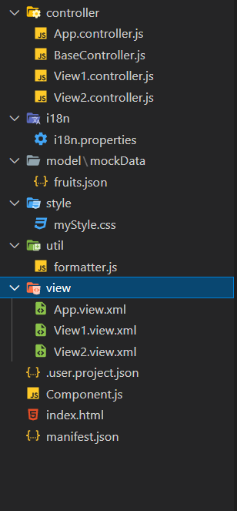
Structure of fiori application setup
There are different folders and directory are required for setup project
Webapp = This provides the root directory and of all files given in alias name or namespace
Controller = The controller folder contains all the controllers used by your views, and might also contain additional logic files that are used by one or more controllers. The structure of the controller folder should mirror the view folder.
models = It contains .json file and object of data
utils = It is the reuse file of JS code
view = It contains all the .xml files.
Component.js = It is the starting file of our app
manifest.json = It is the application descriptor file.
Index.html

Slide 6
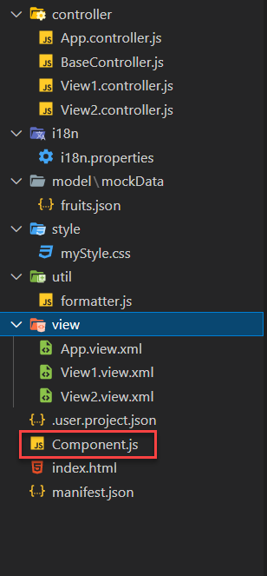
What is Component.js
Component.js the starting point of ANY fiori app. If an app has Component.js inside, its called fiori like app.
The Component.js file is the component controller and provides the runtime metadata and the component methods.
It is the wrapper of all the functionality. We never start any productive code in index.html, rather its all kept in Component.js
It is a class which inherits from sap/ui/core/UIComponent standard class. We inherit to reuse the functionality offered by SAP like routing.
When app starts, UI5 framework will scan your project’s base directory to check if it has a file with exact name Component.js
The component file calls the manifest file and we keep all app level configuration inside the manifest file.
It is also important from the point of view that we will instantiate all models for our application inside the manifest file. The model instantiated in manifest file are directly set on the component and not on the root view.

Slide 7
Skeleton of Component.js
sap.ui.define([
'sap/ui/core/UIComponent'
], function(UIComponent) {
'use strict';
return UIComponent.extend("anubhav.app.Component",{
metadata: {},
init: function(){
},
createContent: function(){
},
destroy: function(){
}
});
});

Slide 8
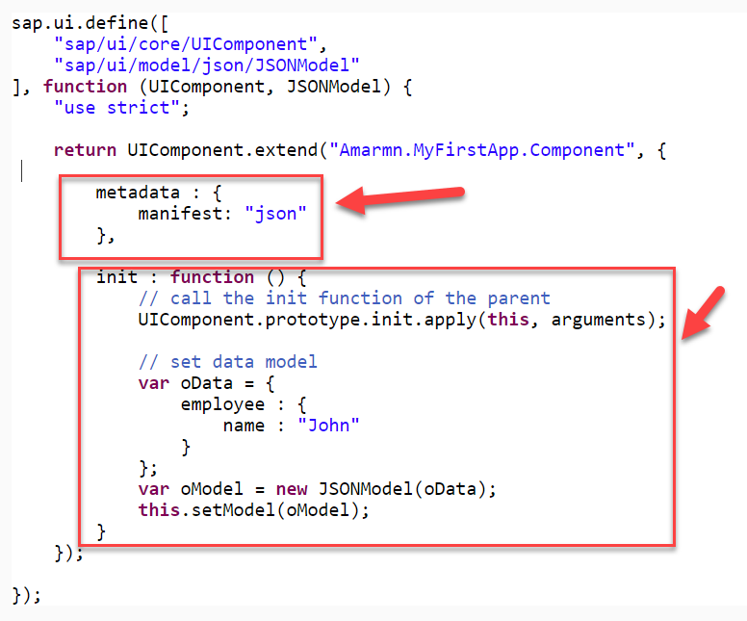
Component.js file has two important parts:
The metadata section. It has property key manifest and value json. This property calls the manifest.json file which is also know as the app descriptor file. It holds all app level configuration and helps keep our Component file clean thereby clearly separating application coding from configuration settings.
Another section of component file is the init function that is called when the component is initialized. When the component is instantiated, the init function is automatically invoked.

Slide 9

Exercise
Design simple a Fiori Application
Create a webapp folder
1.1 Create Two folder as controller and view
2. Controller and View section section
2.1 App.controller.js
2.2 BaseController.js
2.3 View1 controller
2.4 View2 Controller
2.5 App.view.xml
2.6 View1.view.xml
2.7 View2.view.xml
3. Component.js
4. index.html

Slide 10
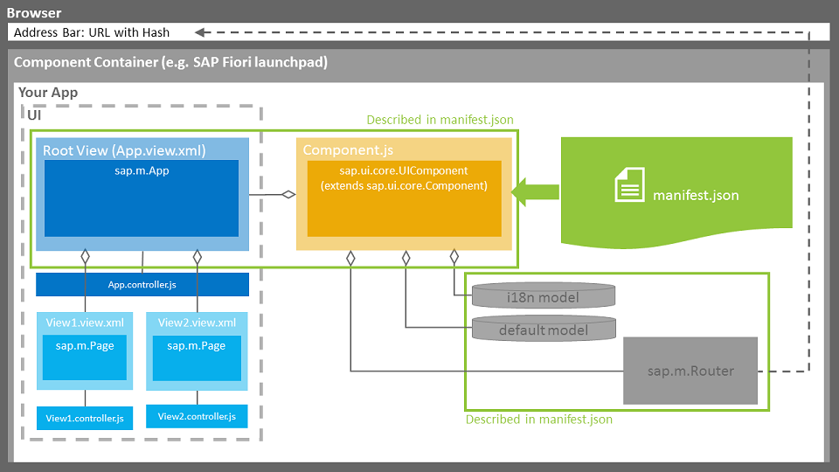
App Overview: The Basic Files of App

Slide 11
List Control
The list contains various list items. These items can be of various types depending on the use case and on the content they have. SAPUI5 already provides the most common list items in SAP Fiori in the form of controls, although custom list items can also be created if necessary.
Reference: https://sapui5.hana.ondemand.com/#/entity/sap.m.List
sap.m.ListBase
Item 0
Item 1
Item 2
….
….
….
ListItemBase
sap.m.List
DisplayListItem
StandardListItem
items
InputListItem
CustomListItem
ColumnListItem
FeedListItem
ObjectListItem
ActionListItem

Slide 12

Exercise 2
In this exercise we are going to show currency code in the table.
We will convert the currency code into it corresponding currency symbol.
We will achieve this by using a formatter function.
Exercise Code:-
View1.view.xml
View1.controller.js

Slide 13

End of Day 11

Slide 14

Any Questions ?

Slide 15

Anubhav Oberoy

Slide 16
Title
Content

